Slide 1
Machine Learning 02- Mathematics for Machine Learning
Dr. Malak Abdullah
Computer Science Department
Jordan University of Science and Technology

Slide 2
ALGEBRA

Slide 3
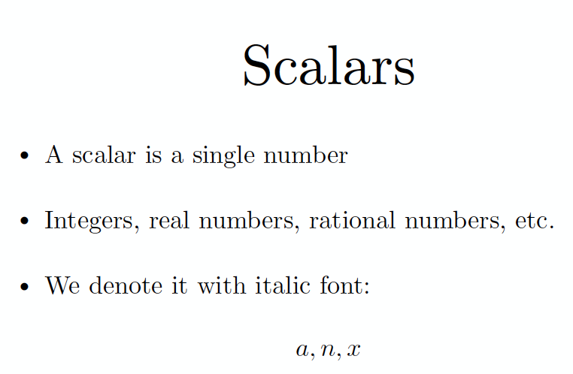

Slide 4
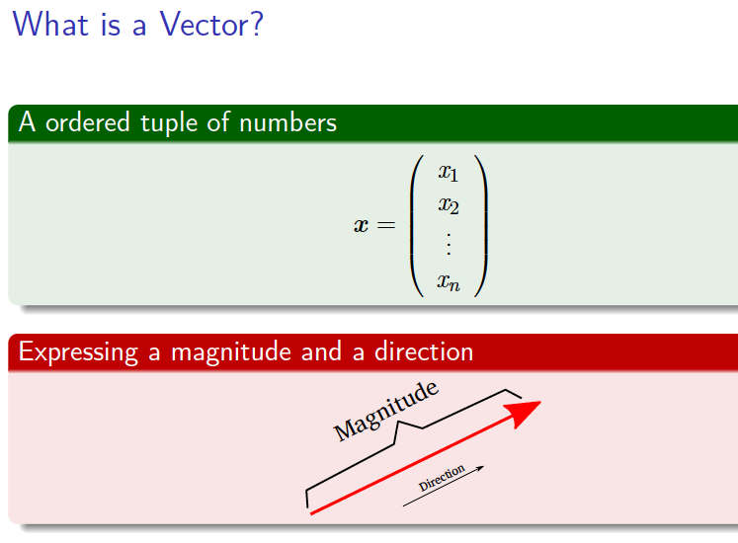
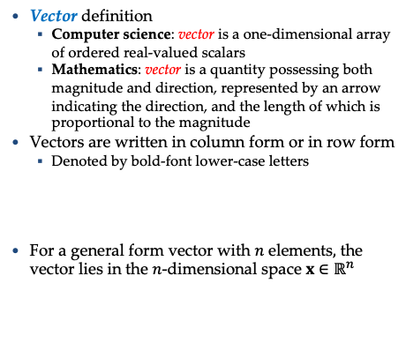
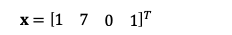
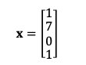
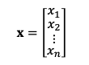
Vectors
Vector definition
Computer science: vector is a one-dimensional array of ordered real-valued scalars
Mathematics: vector is a quantity possessing both magnitude and direction, represented by an arrow indicating the direction, and the length of which is proportional to the magnitude
Vectors are written in column form or in row form
Denoted by bold-font lower-case letters
For a general form vector with $n$ elements$,$ the vector lies in the $n$-dimensional space ${x∈ℝ}^{n}$
$x=\left[\begin{matrix}1 \\ \begin{matrix}7 \\ 0\end{matrix} \\ 1\end{matrix}\right]$
$x={\left[\begin{matrix}1 & 7 & \begin{matrix}0 & 1\end{matrix}\end{matrix}\right]}^{T}$
$x=\left[\begin{matrix}x_{1} \\ \begin{matrix}x_{2} \\ ⋮\end{matrix} \\ x_{n}\end{matrix}\right]$

Slide 5
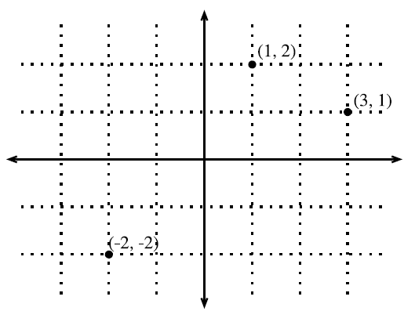
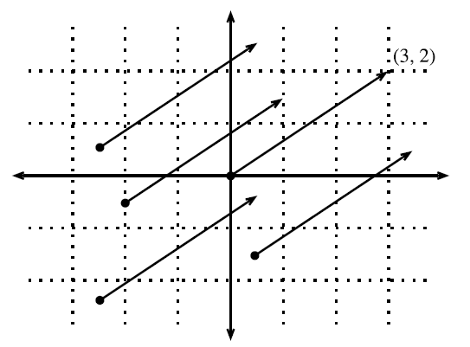
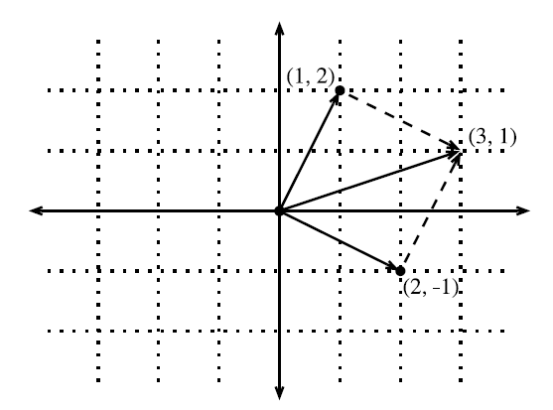
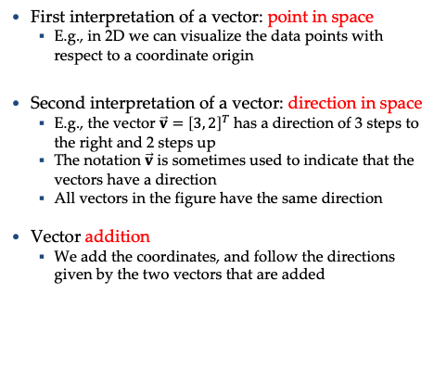
Geometry of Vectors
First interpretation of a vector: point in space
E.g., in 2D we can visualize the data points with respect to a coordinate origin
Second interpretation of a vector: direction in space
E.g., the vector $\vec{v}={\left[3, 2\right]}^{T}$ has a direction of 3 steps to the right and 2 steps up
The notation $\vec{v}$ is sometimes used to indicate that the vectors have a direction
All vectors in the figure have the same direction
Vector addition
We add the coordinates, and follow the directions given by the two vectors that are added
Picture from: http://d2l.ai/chapter_appendix-mathematics-for-deep-learning/geometry-linear-algebraic-ops.html#geometry-of-vectors

Slide 6
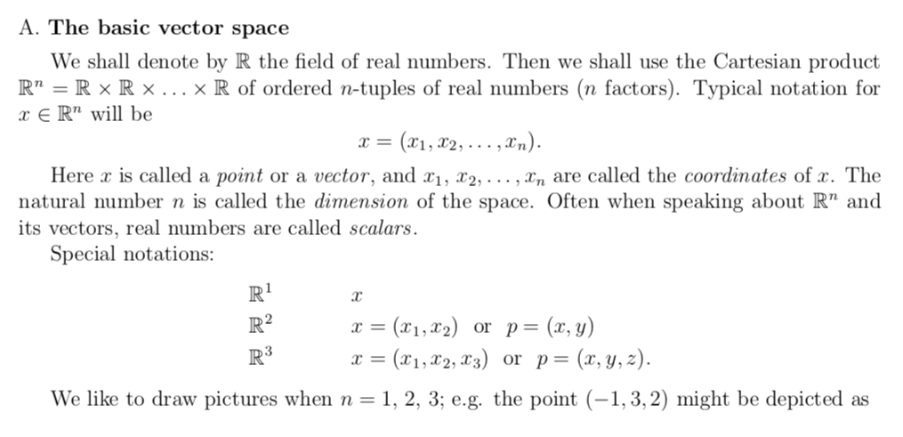
Vectors Basics

Slide 7
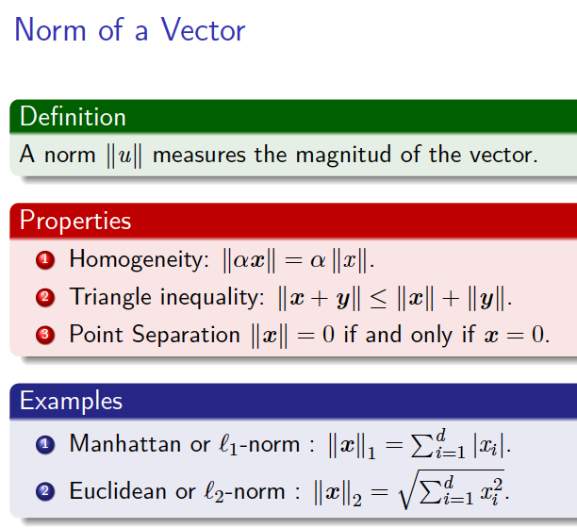
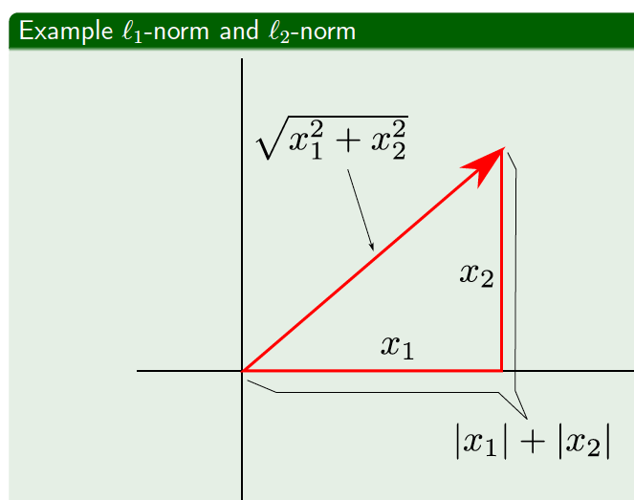
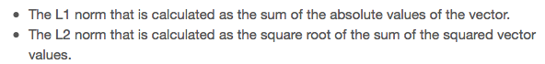
Norm

Slide 8
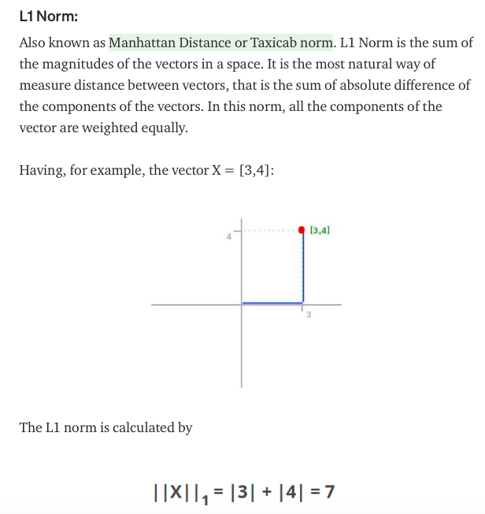
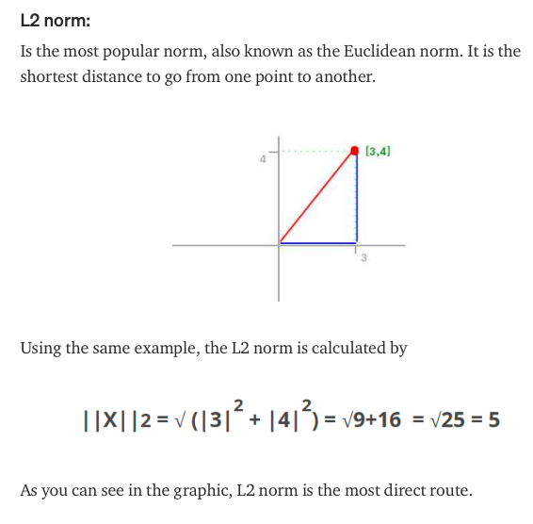

Slide 9
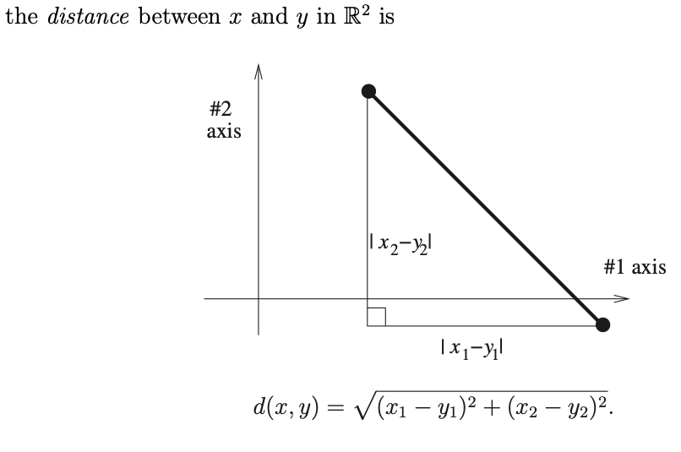
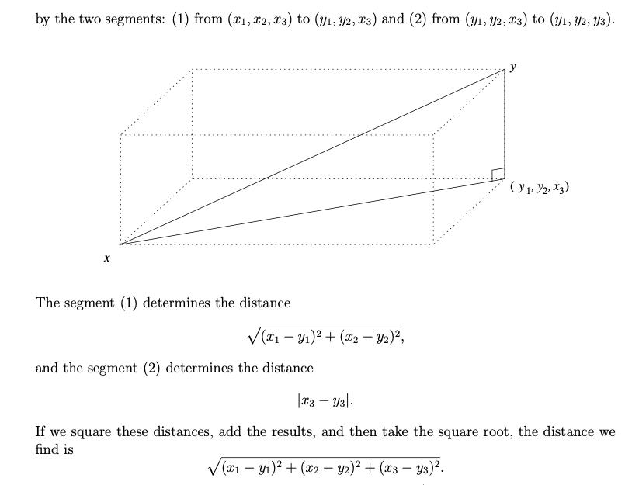
Distance between two points

Slide 10
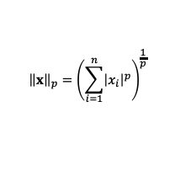
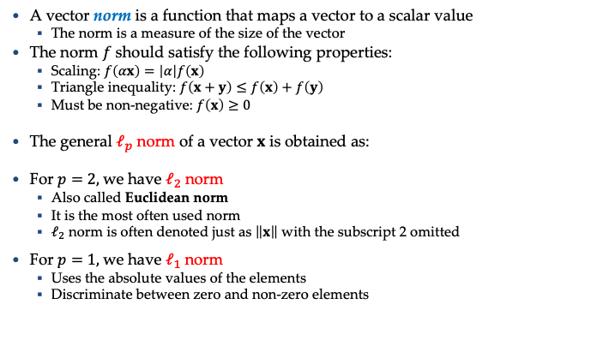
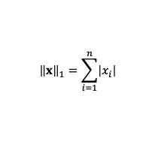
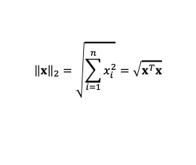
Norm of a Vector
A vector norm is a function that maps a vector to a scalar value
The norm is a measure of the size of the vector
The norm $f$ should satisfy the following properties:
Scaling: $f\left(αx\right)=\left|α\right|f\left(x\right)$
Triangle inequality: $f\left(x+y\right)≤f\left(x\right)+f\left(y\right)$
Must be non-negative: $f\left(x\right)≥0$
The general $ℓ_{p}$ norm of a vector $x$ is obtained as:
For $p=2,$we have $ℓ_{2}$ norm
Also called Euclidean norm
It is the most often used norm
$ℓ_{2}$ norm is often denoted just as $\left\|x\right\|$ with the subscript 2 omitted
For $p=1,$we have $ℓ_{1}$ norm
Uses the absolute values of the elements
Discriminate between zero and non-zero elements
$${\left\|x\right\|}_{p}={\left(\sum_{i=1}^{n}{{\left|x_{i}\right|}^{p}}\right)}^{\frac{1}{p}}$$
$${\left\|x\right\|}_{2}=\sqrt{\sum_{i=1}^{n}{x_{i}^{2}}}=\sqrt{x^{T}x}$$
$${\left\|x\right\|}_{1}=\sum_{i=1}^{n}{\left|x_{i}\right|}$$

Slide 11
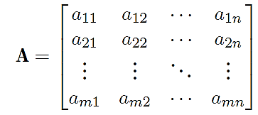
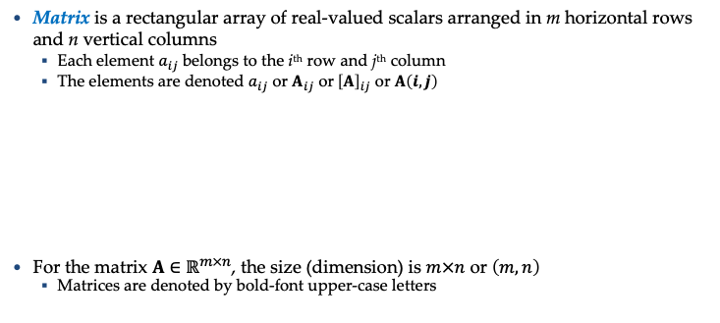
Matrices
Matrix is a rectangular array of real-valued scalars arranged in m horizontal rows and n vertical columns
Each element $a_{ij}$ belongs to the i^{th} row and j^{th} column
The elements are denoted $a_{ij}$ or $A_{ij}$ or${ \left[A\right]}_{ij}$ or $A\left(i,j\right)$
For the matrix $A∈ℝ^{m×n}$, the size (dimension) is $m×n$ or $\left(m,n\right)$
Matrices are denoted by bold-font upper-case letters

Slide 12
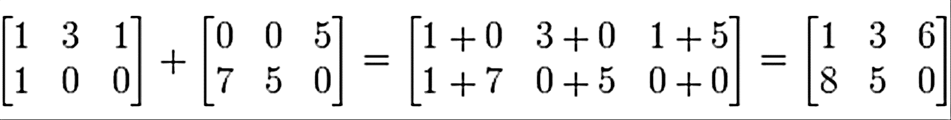
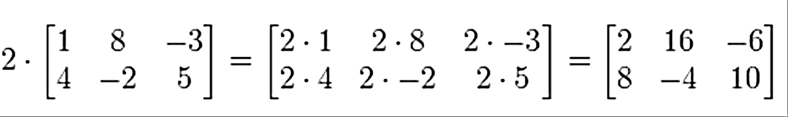
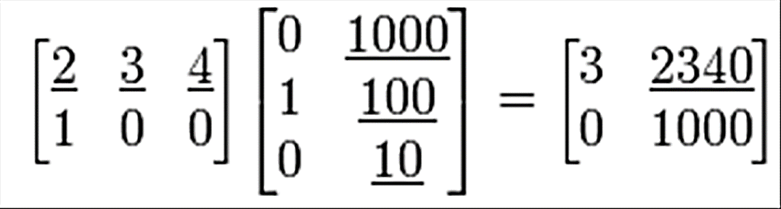
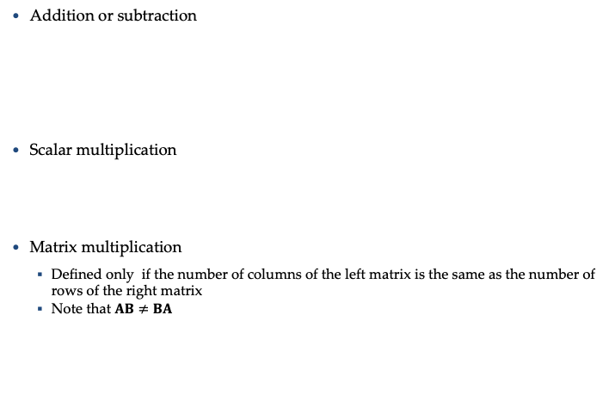
Matrices
Addition or subtraction
Scalar multiplication
Matrix multiplication
Defined only if the number of columns of the left matrix is the same as the number of rows of the right matrix
Note that $AB≠BA$

Slide 13
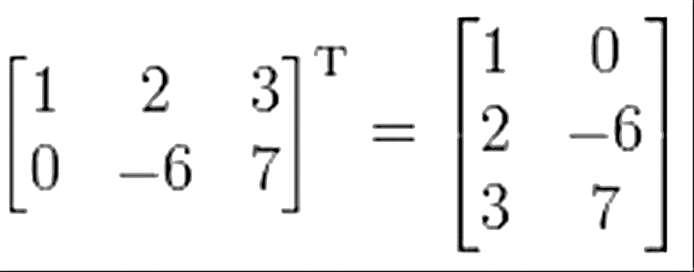
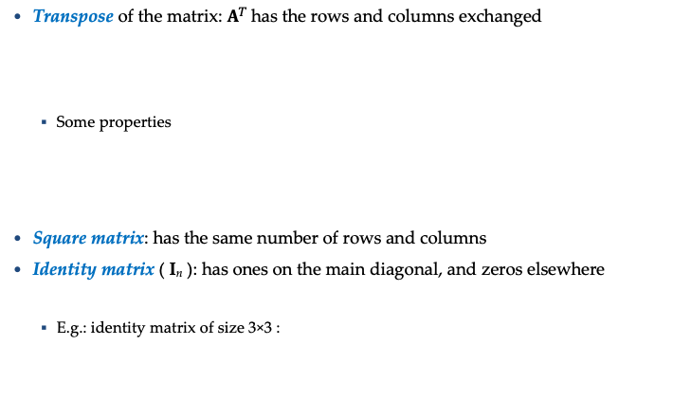
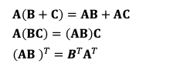
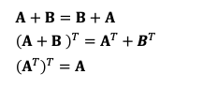
Matrices
Transpose of the matrix: $A^{T}$has the rows and columns exchanged
Some properties
Square matrix: has the same number of rows and columns
Identity matrix ( I_{n} ): has ones on the main diagonal, and zeros elsewhere
E.g.: identity matrix of size 3×3 :
$$A+B=B+A$$
$${\left(A+B \right)}^{T}=A^{T}+B^{T}$$
$${\left(A^{T}\right)}^{T}=A$$
$$A\left(B+C\right)=AB+AC$$
$$A\left(BC\right)=\left(AB\right)C$$
$${\left(AB \right)}^{T}=B^{T}A^{T}$$

Slide 14
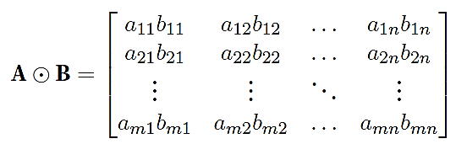
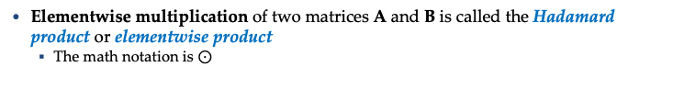
Matrices
Elementwise multiplication of two matrices A and B is called the Hadamard product or elementwise product
The math notation is $⊙$

Slide 15
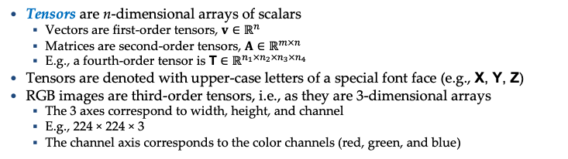
Tensors
Tensors are n-dimensional arrays of scalars
Vectors are first-order tensors, $v∈ℝ^{n}$
Matrices are second-order tensors, $A∈ℝ^{m×n}$
E.g., a fourth-order tensor is $\text{T}∈ℝ^{n_{1}×n_{2}×n_{3}×n_{4}}$
Tensors are denoted with upper-case letters of a special font face (e.g., $\text{X}\text{, }\text{Y}\text{, }\text{Z}$)
RGB images are third-order tensors, i.e., as they are 3-dimensional arrays
The 3 axes correspond to width, height, and channel
E.g., 224 × 224 × 3
The channel axis corresponds to the color channels (red, green, and blue)

Slide 16
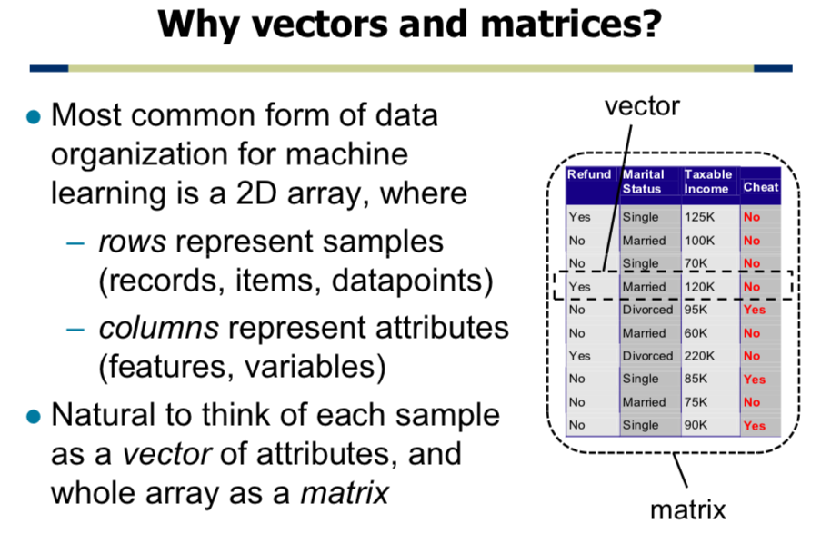

Slide 17

Numpy
NumPy is a library for the Python programming language, adding support for large, multi-dimensional arrays and matrices, along with a large collection of high-level mathematical functions to operate on these arrays
Numpy array creation
Array access and operations
Basic linear algebra

Slide 18
Numpy
Stands for Numerical Python an efficient multi-dimensional container for generic data
is the fundamental package required for high performance computing and data analysis
It provides
ndarray for creating multiple-dimensional arrays
Standard math functions for fast operations on entire arrays of data without having to write loops
Tools for reading/writing array data
Linear algebra tools
etc.

Slide 19
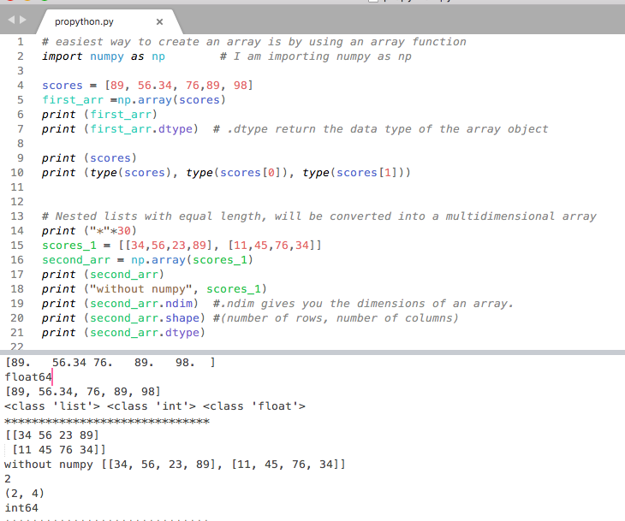

Slide 20
ndarray vs list of lists
gArray = np.array(examGrades)
In [5]: gArray[0,2]. # gArray[0][2]
Out[5]: 60
In [7]: gArray[2,:] #gArray[2]
Out[7]: array([99, 67, 84])
In [8]: gArray[:, 0]
Out[8]: array([79, 95, 99, 76, 91, 70, 88, 67, 82, 94])
In [9]: gArray[:3, :2]
Out[9]:
array([[79, 95],
[95, 60],
[99, 67]])
In [3]: gArray
Out[3]:
array([[79, 95, 60],
[95, 60, 61],
[99, 67, 84],
...,
[67, 73, 80],
[82, 89, 61],
[94, 67, 88]])

Slide 21
The N-dimensional array (ndarray)
The number of dimensions and items in an array is defined by its shape, which is a tuple of N non-negative integers that specify the sizes of each dimension.
The type of items in the array is specified by a separate data-type object (dtype), one of which is associated with each ndarray.
As with other container objects in Python, the contents of an ndarray can be accessed and modified by indexing or slicing the array (using, for example, N integers), and via the methods and attributes of the ndarray.
In [15]: type(gArray)
Out[15]: numpy.ndarray
In [16]: gArray.ndim
Out[16]: 2
In [17]: gArray.shape
Out[17]: (10, 3)
In [18]: gArray.dtype
Out[18]: dtype('int32')

Slide 22
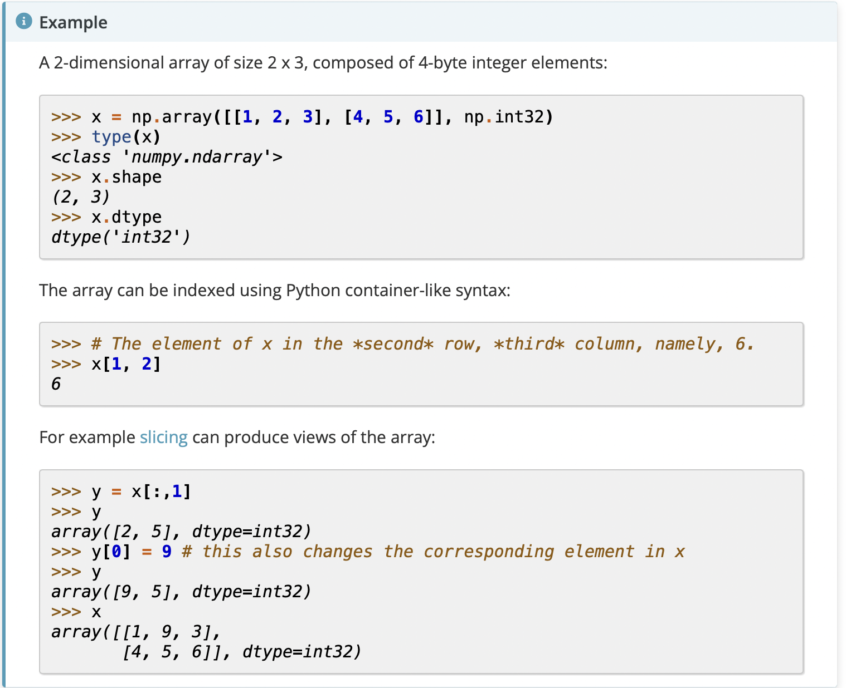

Slide 23
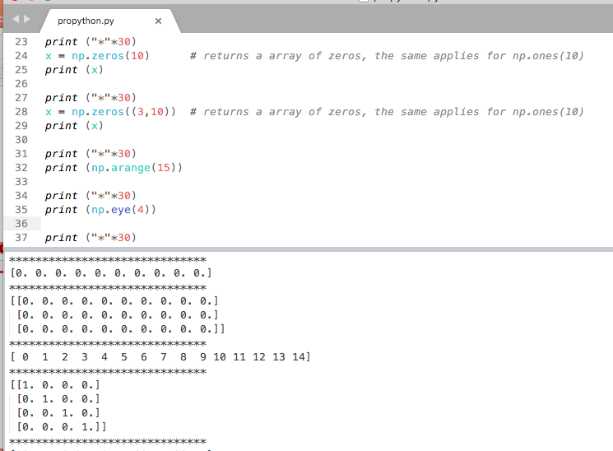
Examples

Slide 24
Creating ndarrays
In [69]: np.eye(3)
Out[69]:
array([[ 1., 0., 0.],
[ 0., 1., 0.],
[ 0., 0., 1.]])
In [70]: np.arange(0, 10, 2)
Out[70]: array([0, 2, 4, 6, 8])
np.array
np.zeros
np.ones
np.eye
np.arange
np.random
In [65]: np.array([[0,1,2],[2,3,4]])
Out[65]:
array([[0, 1, 2],
[2, 3, 4]])
In [66]: np.zeros((2,3))
Out[66]:
array([[ 0., 0., 0.],
[ 0., 0., 0.]])
In [67]: np.ones((2,3))
Out[67]:
array([[ 1., 1., 1.],
[ 1., 1., 1.]])
In [295]: np.random.randint(0, 10, (3,3))
Out[295]:
array([[8, 7, 6],
[0, 8, 9],
[9, 0, 4]])

Slide 25
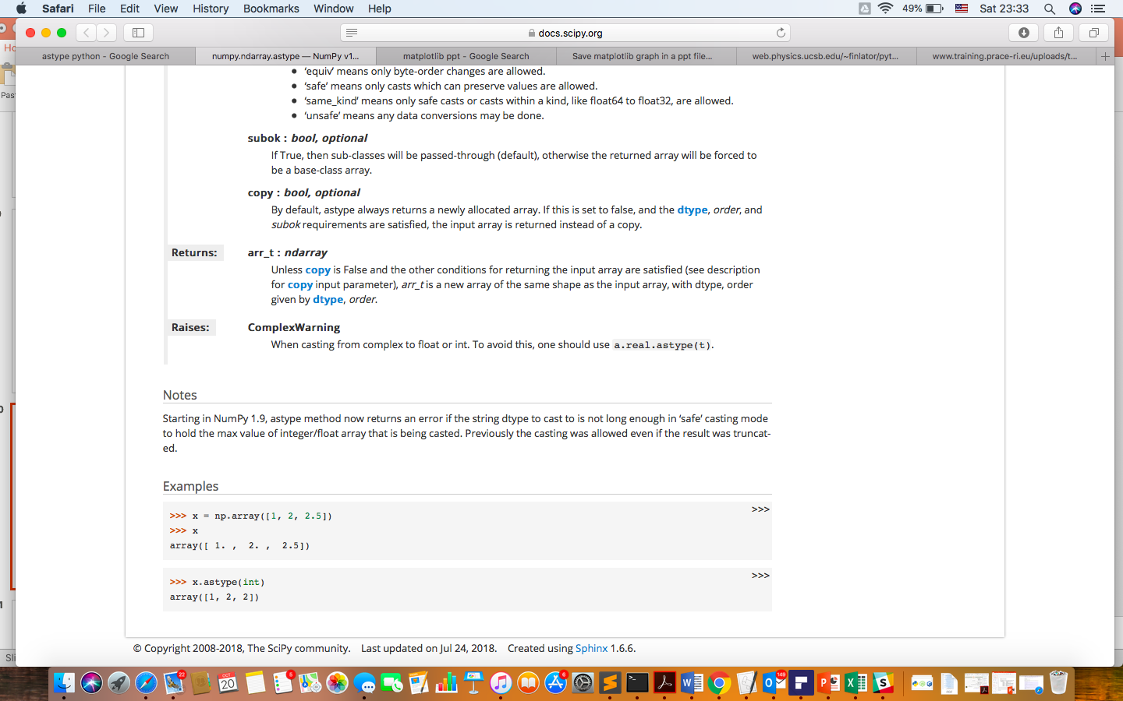
Numpy data types
int8, int16, int32, int64
float16, float32, float64, float128
bool
object
String
Unicode
gArray.astype
In [34]: gArray.astype(float64)
Out[34]:
array([[ 79., 95., 60.],
[ 95., 60., 61.],
...,
[ 82., 89., 61.],
[ 94., 67., 88.]])
64 bits
In [79]: num_string = array(['1.0', '2.05', '3'])
In [81]: num_string
Out[81]:
array(['1.0', '2.05', '3’], dtype='<U4')
In [82]: num_string.astype(float)
Out[82]: array([ 1. , 2.05, 3. ])

Slide 26
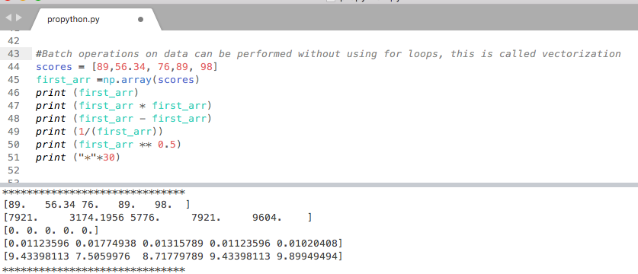
Examples

Slide 27
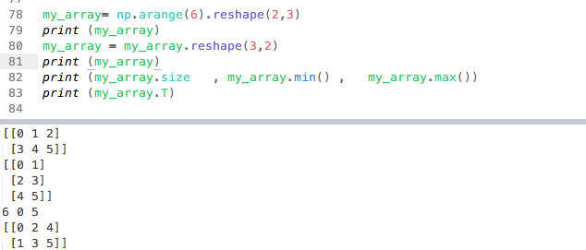
Reshape

Slide 28
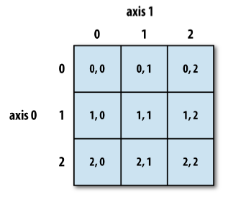
Reshaping and transposing
In [280]: In [77]: np.arange(6).reshape((2,3))
Out[280]:
array([[0, 1, 2],
[3, 4, 5]])
In [281]: In [77]: np.arange(6).reshape((2,3), order='F')
Out[281]:
array([[0, 2, 4],
[1, 3, 5]])
In [290]: np.arange(6).reshape(2,3).T
Out[290]:
array([[0, 3],
[1, 4],
[2, 5]])

Slide 29
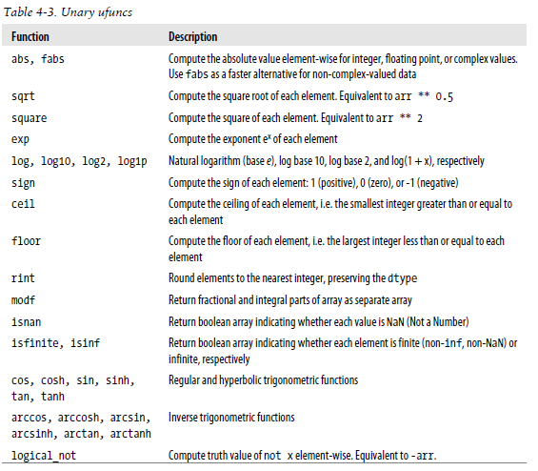
Fast element-wise functions
print (np.sqrt(my_array))

Slide 30
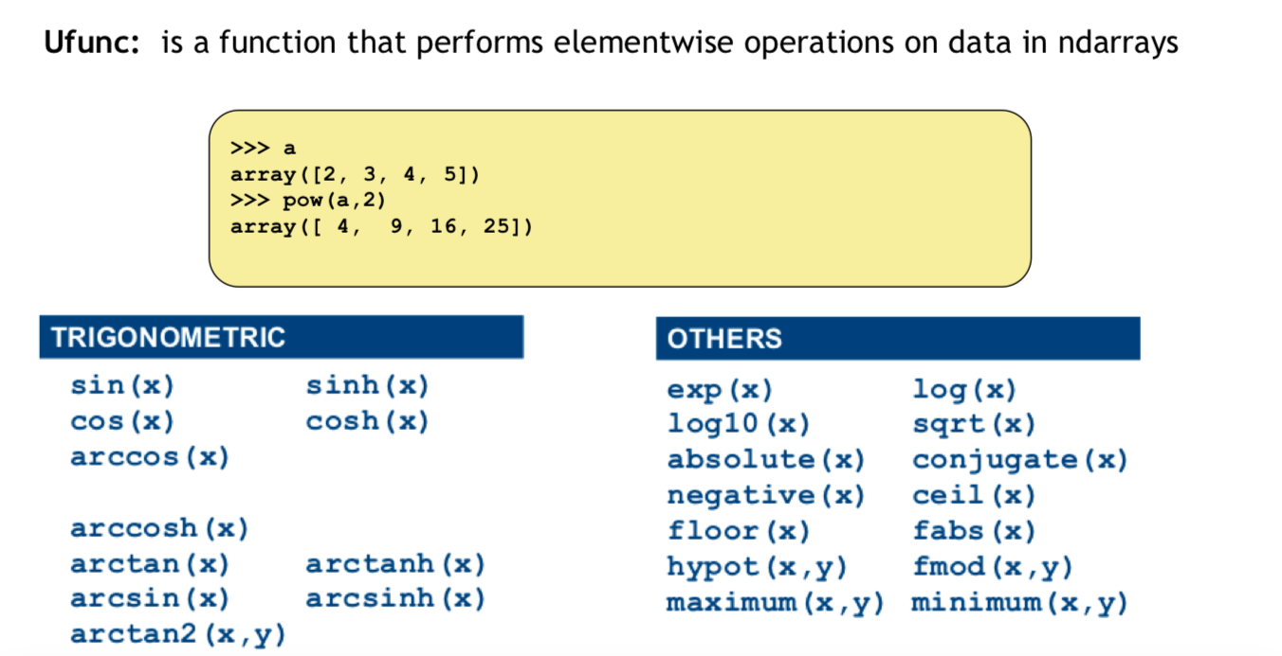

Slide 31
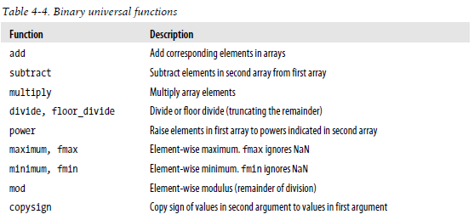
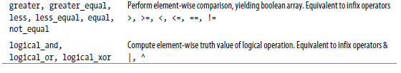
print (np.add(my_array,my_array))
https://docs.scipy.org/doc/numpy/reference/

Slide 32
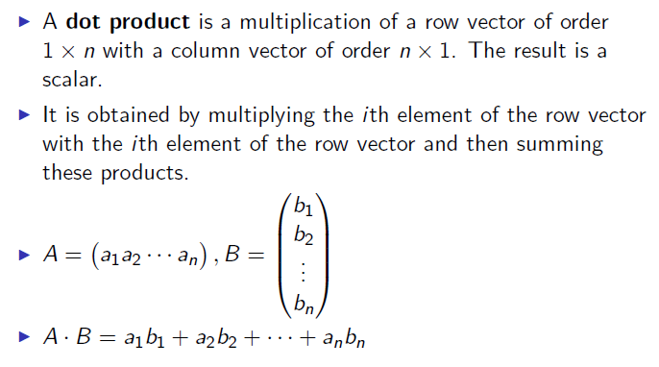
Dot product
In [303]: a = b = np.arange(5)
In [305]: a
Out[305]: array([0, 1, 2, 3, 4])
In [306]: b
Out[306]: array([0, 1, 2, 3, 4])
In [307]: a.dot(b)
Out[307]: 30

Slide 33

More and more: https://numpy.org/doc/stable/reference/arrays.ndarray.html

Slide 34
Probability

Slide 35
Probability review
Random Variable: A variable that takes on different values determined randomly.
• Example: The height of a person from the US.
• Distribution: The different values a random variable can take on along with the probability of that value.
• We talk about sampling from a distribution:
• “Consider a sample of 100 different heights of people from the US drawn randomly from the distribution of all heights.”

Slide 36
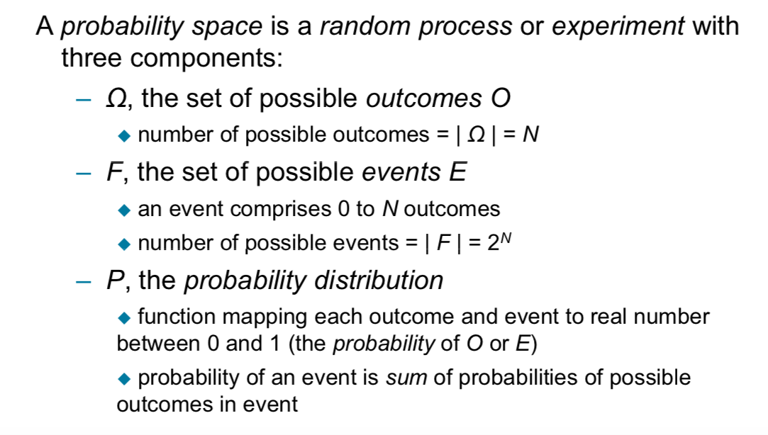
Probability Spaces
Rolling a 6-sided dice: The number of possible outcomes = 6 The number of possible events = 2^6= 64
Example event:
to roll 1 or 6
to roll 1 or 2 or 6 …etc

Slide 37
Probability review
Let X and Y be random variables Ex. X is the outcome of the first roll of a 6-sided dice, Y is the outcome of the second roll of the dice
(X and Y take values in {1,2,3,4,5,6} each with equal probability)
An event is a statement about the world that holds or not: Define events A = {X ∈ {3,4}},
B= {X = 1}, C = {Y ∈ {3,4}}
Every event is assigned a probability: P(A) = P(X ∈ {3,4}) = 1/3
For any events U, V we have P(U ∪ V ) = P(U ) + P(V ) − P(U ∩ V )

Slide 38
Probability review
Let X and Y be random variables Ex. X is the outcome of the first roll of a 6-sided dice, Y is the outcome of the second roll of the dice
(X and Y take values in {1,2,3,4,5,6} each with equal probability)
An event is a statement about the world that holds or not:
Define events A = {X ∈ {3,4}},
B = {X = 1}, C = {Y ∈ {3,4}}
Every event is assigned a probability: P(A) = P(X ∈ {3,4}) = 1/3
For any events U, V we have P(U ∪ V ) = P(U ) + P(V ) − P(U ∩ V ) For say events U, V are independent if P(U ∩ V ) = P(U )P(V )
Are A, B independent? B,C? A, C?
No
yes
yes

Slide 39
Probability review
Let X and Y be random variables Ex. X is the outcome of the first roll of a 6-sided dice, Y is the outcome of the second roll of the dice
(X and Y take values in {1,2,3,4,5,6} each with equal probability)
An event is a statement about the world that holds or not:
Define events A = {X ∈ {3,4}},
B= {X = 1}, C = {Y ∈ {3,4}}
Every event is assigned a probability: P(A) = P(X ∈ {3,4}) = 1/3
For any events U, V we have P(U ∪ V ) = P(U ) + P(V ) − P(U ∩ V )

Slide 40
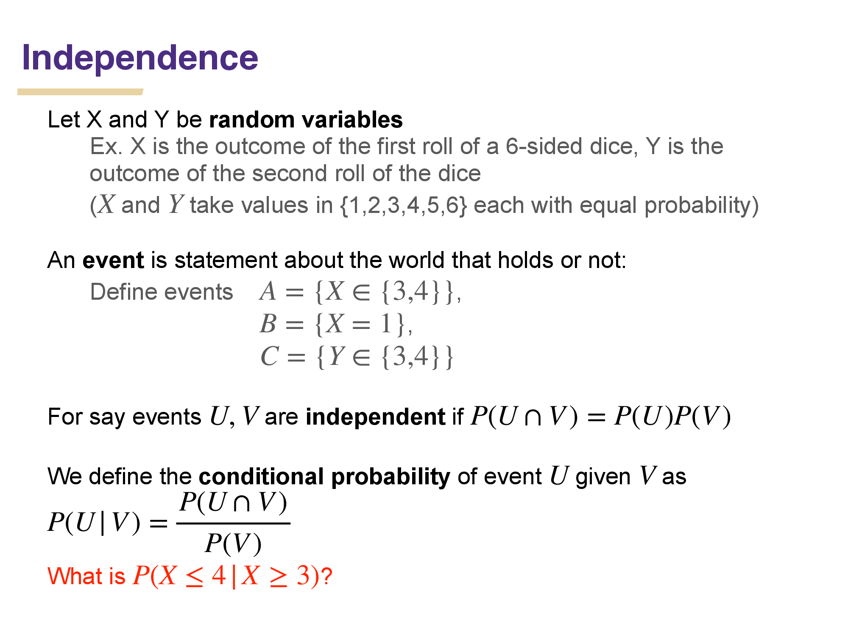


Slide 41


Slide 42


Slide 43


Slide 44


Slide 45


Slide 46

OR. Union

Slide 47


Disjoint

Slide 48


Exhaustive events

Slide 49


Slide 50

The probability that a continuous random variable will assume a particular value is zero.

Slide 51

https://www.youtube.com/watch?v=Fvi9A_tEmXQ

Slide 52



Slide 53



Slide 54

For instance, the probability of a coin flip giving a head is considered a marginal probability because we aren’t considering any other events.

Slide 55



